Slide 1

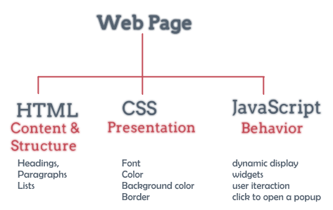
Form and Controls

Slide 2
Lesson Objectives
Mastering the knowledge of Form
Understand the working mechanism of GET, POST, PUT, DELETE
Master and use the controls on the Form

Slide 3
Lesson content
Introduction to Form
Distinguish GET/POST/PUT/DELETE method
Controls on the Form

Slide 4
1. Introduction to Form
Forms allows users to enter data on the website. This data can be sent to the server for processing.
The user enters data through the controls. There are many types of controls:
Label, Textbox
Button, Checkbox, Radio Button
Combo box (drop-down menu), Listbox
TextArea
…

Slide 5
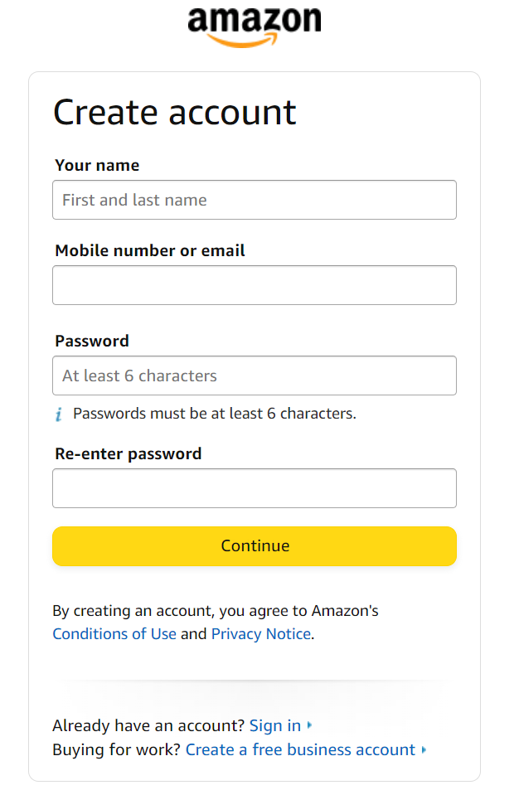
1. Introduction to Form

Slide 6
1. Introduction to Form
The form is where other input elements are stored.
Not visible when web page is displayed
Attributes of <form>
name: name of FORM
action : specifies the web page that will receive data processing from this FORM when there is a click event of the SUBMIT button.
method : Define data transfer method (POST, GET, PUT, DELETE)
…..

Slide 7
1. Introduction to Form
<FORM ACTION = url METHOD = GET | POST NAME = name TARGET = frame_name | _blank | _self > <INPUT ...> <INPUT ...> </FORM>
<INPUT TYPE = BUTTON | CHECKBOX | FILE | IMAGE | PASSWORD | RADIO | RESET | SUBMIT | TEXT NAME= string VALUE = string ALIGN = LEFT | CENTER | RIGHT />

Slide 8
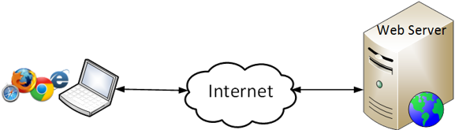
2. Distinguish GET/POST/PUT/DELETE method
How to use the GET Method
How to use the POST Method
How to use the PUT Method
How to use the DELETE Method
➔These 4 types of methods allow us to transfer data from the Client to the Server to process data, each method will have a different way of transmitting and receiving data (depending on the technical processing purpose of the Programmer).

Slide 9
Using the GET Method
Form arguments are included in the URL of the Action attribute in the <Form> . tag
The amount of form argument data transmitted is limited by the maximum length of a URL in the Address bar. (maximum of a URL is 2048 bytes)
Usually used to send data and query data back to the Client

Slide 10

Using the GET Method
Design a simple form including 2 textboxes and 1 submit button
<form action="form_action.asp" method="get"> First name: <input type="text" name="fname" value=“Mickey”/><br /> Last name: <input type="text" name="lname" value=“Mouse”/><br /> <input type="submit" value="Submit" />
</form>
When the user selects the Submit button, the data in the 2 textboxes will be transmitted by the get method

Slide 11
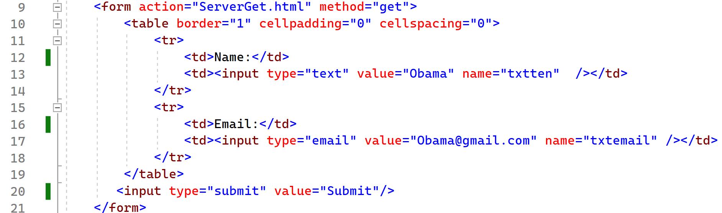
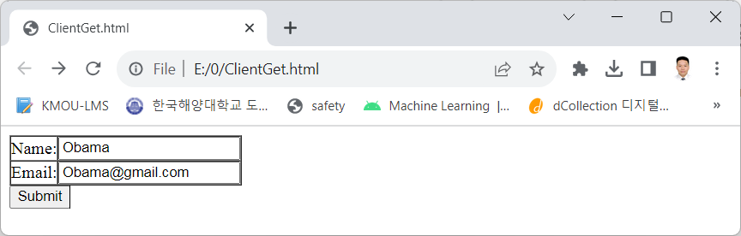
Using the GET Method
For example:
ClientGet.html

Slide 12
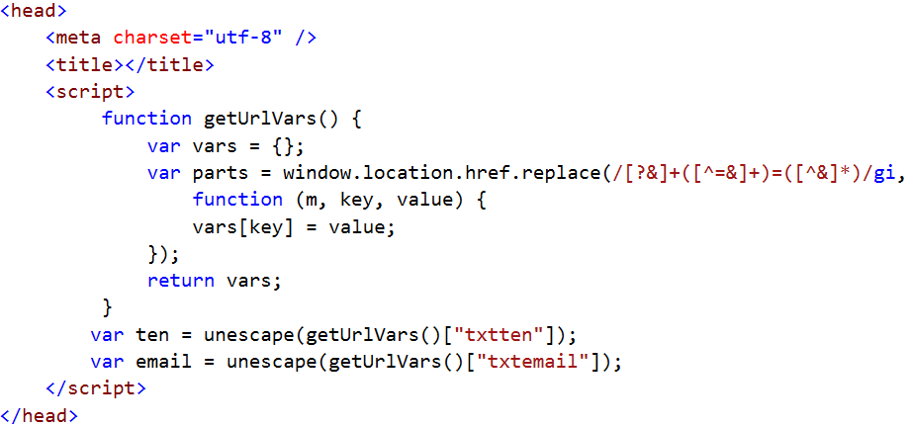
Using the GET Method
For example:
ServerGet.html

Slide 13
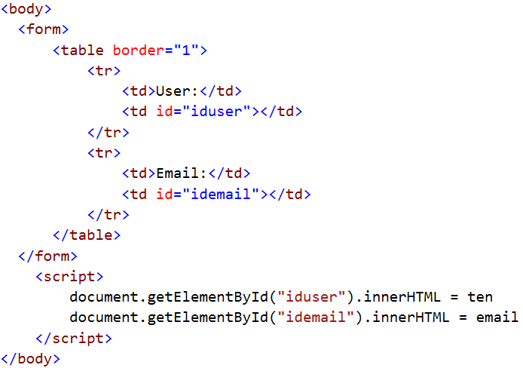
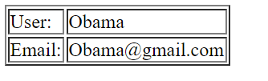
Using the GET Method
ServerGet.html
Ví dụ:
ServerGet.html?txtten=Obama&txtemail=Obama%40gmail.com

Slide 14
Using the POST Method
Form arguments are passed "implicitly" below
The amount of Form's passed argument data does not depend on the URL Unlimited
The POST method can only be used when the Action specified to the web page is processed on the Server
➔Post method is often used to save new data from the Client to the Server

Slide 15

Using the POST Method
Design a simple form including 2 textboxes and 1 submit button
<form action="form_action.asp" method=“post"> First name: <input type="text" name="fname" value=“Mickey”/><br /> Last name: <input type="text" name="lname" value=“Mouse”/><br /> <input type="submit" value="Submit" />
</form>
When the user selects the
Submit button, the data in
the 2 textboxes will be
transmitted by the post method

Slide 16
Using the PUT Method
Similar to the POST method, often used to Update data from the Client to the Server
<form action="form_action.asp" method=“put"> First name: <input type="text" name="fname" value=“Mickey”/><br /> Last name: <input type="text" name="lname" value=“Mouse”/><br /> <input type="submit" value="Submit" />
</form>

Slide 17
Using the DELETE Method
Similar to the PUT method, often used to delete data from the Client sent to the Server
<form action="form_action.asp" method=“delete"> First name: <input type="text" name="fname" value=“Mickey”/><br /> Last name: <input type="text" name="lname" value=“Mouse”/><br /> <input type="submit" value="Submit" />
</form>

Slide 18
3. Form Controls
Label
Textbox
Button
fieldset, legend
Checkbox, Radio Button
ComboBox, Listbox
Option group
TextArea
Hidden field
File Upload

Slide 19
Label
<label></label>
Create titles for the controls in the form
Attributes:
for=“id_control”:
id of the control associated with the label
when clicking on the label will focus to that control

Slide 20
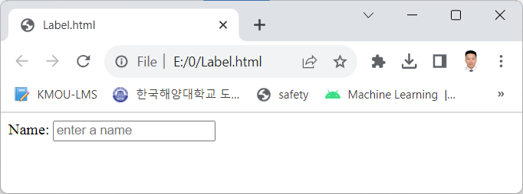
Label
<label for="txtName">Name:</label>
<input id="txtName" placeholder="enter a name" type="text" name="txtName" value="" />

Slide 21
Textbox
Use to enter short texts (over 1 line) or passwords
Tag: <input>
Attributes:
name=“name”: important
type=“text”: plain text field, “password”: password field, “email”: Email input field, “url” : URL input field, “number”: Number input field
value=“default value”
placeholder="suggested text"
required

Slide 22
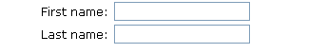
Textbox – Regular Text
<input type="text" /> textbox definition
<form> First name: <input type="text" name="firstname" />
<br /> Last name: <input type="text" name="lastname" /> </form>
Show in browser

Slide 23
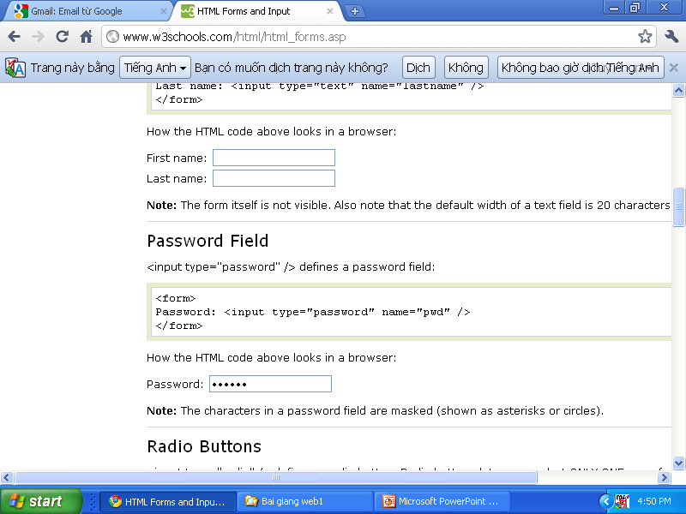
Textbox – Password
<input type="password" /> Define a Password Field
<form> Password: <input type="password" name="pwd" /> </form>
Show in browser
Text when typed in Password Field will be encrypted

Slide 24

Textbox – enter number
<input name="n" type="number" min="0" max="10" step="2" value="6">
<input name="r" type="range" min="1" max="11" value="9">

Slide 25

Textbox – enter email, url
<input type=“email” />
<input type=“url” />
Data is checked before submission

Slide 26

Button
Used for the user to command to do the job.
There are 3 types of buttons on the web :
submit: programmers handle themselves
reset: reset all data to default state
normal: programmers handle themselves
Attributes:
name=“name of button”
type=“submit”, “reset”, “button”
value=“text for the button”

Slide 27
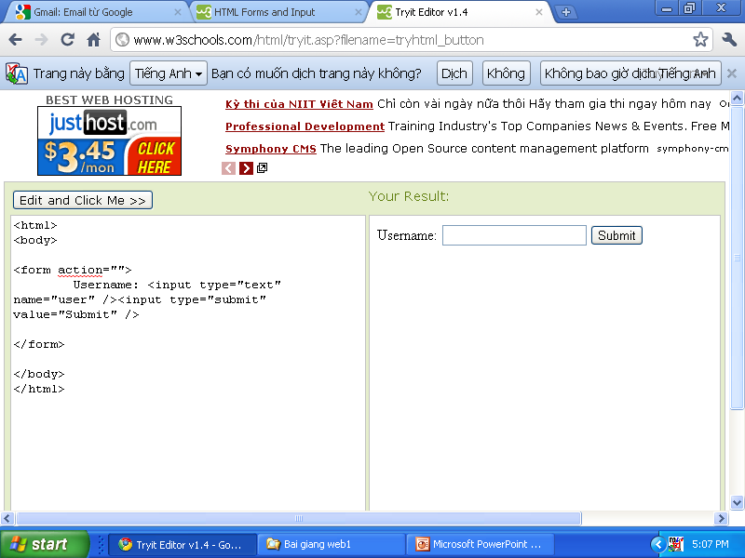
Button
<input type="submit / reset / button" /> used to define button
<form>
Username: <input type="text" name="user" /> <input type="submit" value="Submit" />
</form>
Show in browser

Slide 28
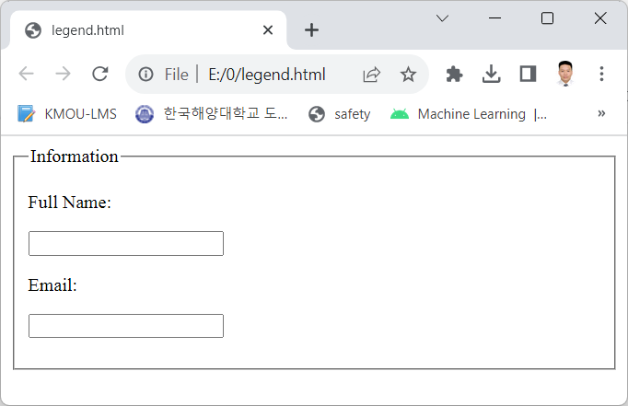
fieldset, legend
<fieldset>
Grouping controls together
<legend>
Group title

Slide 29
fieldset, legend
<fieldset>
<legend>Information</legend>
<p>Full Name: </p>
<p><input type="text"></p>
<p>Email: </p>
<p><input type="text"></p>
</fieldset>

Slide 30
Checkbox
Checkbox used to select multiple options in a selection group given by checked
Tag: <input>
Attributes:
name
type=“checkbox”
value=“value”: this is the value the program will get if the user selects this box.
checked

Slide 31

Checkbox
<input type="checkbox" /> define a checkbox
<form> <input type="checkbox" name="vehicle1“ value="Bike" />
I have a bike
<br /> <input type="checkbox" name="vehicle2“ value="Car" />
I have a car </form>
Show in browser

Slide 32
Radio Button
Radio Button is used to select an option in a given selection group.
On a form, there can be many groups to choose this type.
Tag: <input>
Attributes:
name.
type=“radio”
value=“value”: This is the value the program will get if the user selects this box.
checked

Slide 33

Radio Button
<input type="radio" /> define radio button, want to group together must have the same name
<form>
<input type="radio" name="sex" value="male" checked=“checked” /> Male <br />
<input type="radio" name="sex" value="female" check=“checked”/> Female
</form>
Display in the Browser:

Slide 34

ComboBox
Consists of a list with multiple elements. Only 1 element is selected at a time
The user can select an element in the list by clicking the arrow to the right of the list box.
List box creation tag : <select>List of Item</select>
attribute: name
Tag that creates an element in a list:
<option>Element title</option>
Attribute:
value=“value”: value the program gets if the element is selected
selected

Slide 35
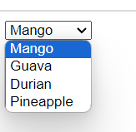
ComboBox
tag <select> is defined Combo Box
<form>
<select name="fruit">
<option value="Mango">Mango</option>
<option value="Guava"> Guava </option>
<option value="Durian"> Durian </option>
<option value="Pineapple "> Pineapple </option>
</select>
</form>
Show in browser

Slide 36

Listbox
Similar to Combo box, however :
can see many elements at the same time
multiple elements can be selected
tag: <select>…</select>
Attribute: similar to combo and has 2 different attributes:
size=“number of row”
multiple: Allows selection of multiple elements at the same time
tag <option>…</option> similar to the combo box

Slide 37
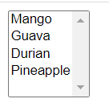
Listbox
tag <select> define the listbox
<form>
<select name="fruit" multiple size="5">
<option value="Mango">Mango</option>
<option value="Guava"> Guava </option>
<option value="Durian"> Durian </option>
<option value="Pineapple "> Pineapple </option>
</select>
</form>
Show in browser

Slide 38
Option group
tag <optgroup>
Grouping options together
Attributes
disabled: not allowed to choose
label=“group name”

Slide 39
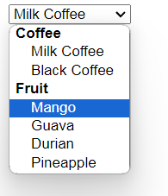
Option group
<select name="menu">
<optgroup label="Coffee">
<option value="milkcofeee">Milk Coffee</option>
<option value="blackcoffee">Black Coffee</option>
</optgroup>
<optgroup label="Fruit">
<option value="Mango">Mango</option>
<option value="Guava"> Guava </option>
<option value="Durian"> Durian </option>
<option value="Pineapple"> Pineapple </option>
</optgroup>
</select>

Slide 40
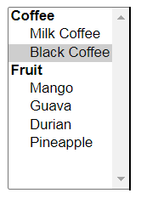
Option group
<select name="menu" multiple size="10">
<optgroup label="Coffee">
<option value="milkcofeee">Milk Coffee</option>
<option value="blackcoffee">Black Coffee</option>
</optgroup>
<optgroup label="Fruit">
<option value="Mango">Mango</option>
<option value="Guava"> Guava </option>
<option value="Durian"> Durian </option>
<option value="Pineapple"> Pineapple </option>
</optgroup>
</select>

Slide 41
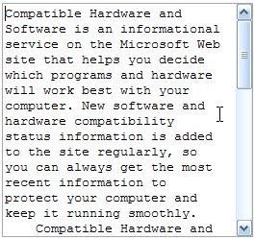
TextArea
TextArea is used to enter long text on multiple lines
Tag:
<textarea>
Default content
</textarea>
Attributes:
name=“name”
rows=“number of row”
cols=“number of column”

Slide 42
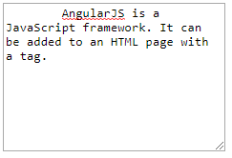
TextArea
tag <textarea>
<textarea rows="10" cols="30">
AngularJS is a JavaScript framework. It can be added to an HTML page with a tag.
</textarea>
Show in browser

Slide 43
Hidden field
Use hidden value storage on the web
Not displayed on the website
Use <input type="hidden" /> tag

Slide 44
File Upload
Used to upload files to the web
<input type="file"> tag
Show in browser

Slide 45


Hey! Coding is easy!
END

